Slide 1
Unit 5
Lecture 4

Slide 2
Dynamic braking of dc shunt motor
The motor is disconnected from the supply mains and the braking resistor(usually variable resistor to control the speed) is connected across the armature.
Now the motor works as generator due to the kinetic energy of the rotation and the electric energy so generated is dissipated as heat in the resistors.
During the braking period the armature current is reversed so the braking torque is developed and speed decreases.
However, the field winding is left connected to the supply. The armature, while slowing down, rotates in a strong magnetic field and, therefore, operates as a generator, sending a large current through resistance R. This causes the energy possessed by the rotating armature to be dissipated quickly as heat in the resistance. As a result, the motor is brought to standstill quickly.

Slide 3
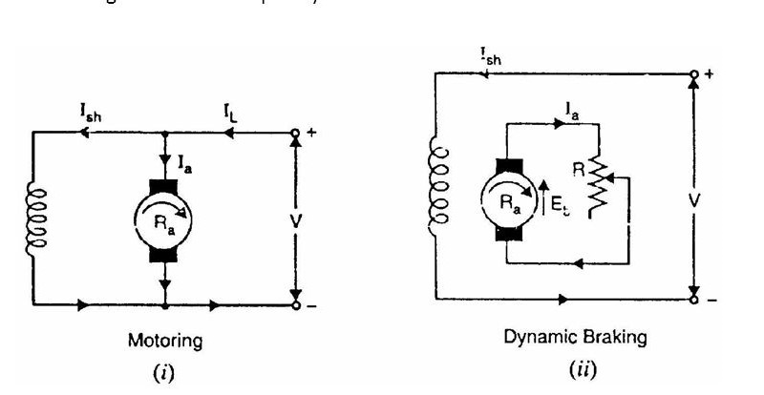

Slide 4
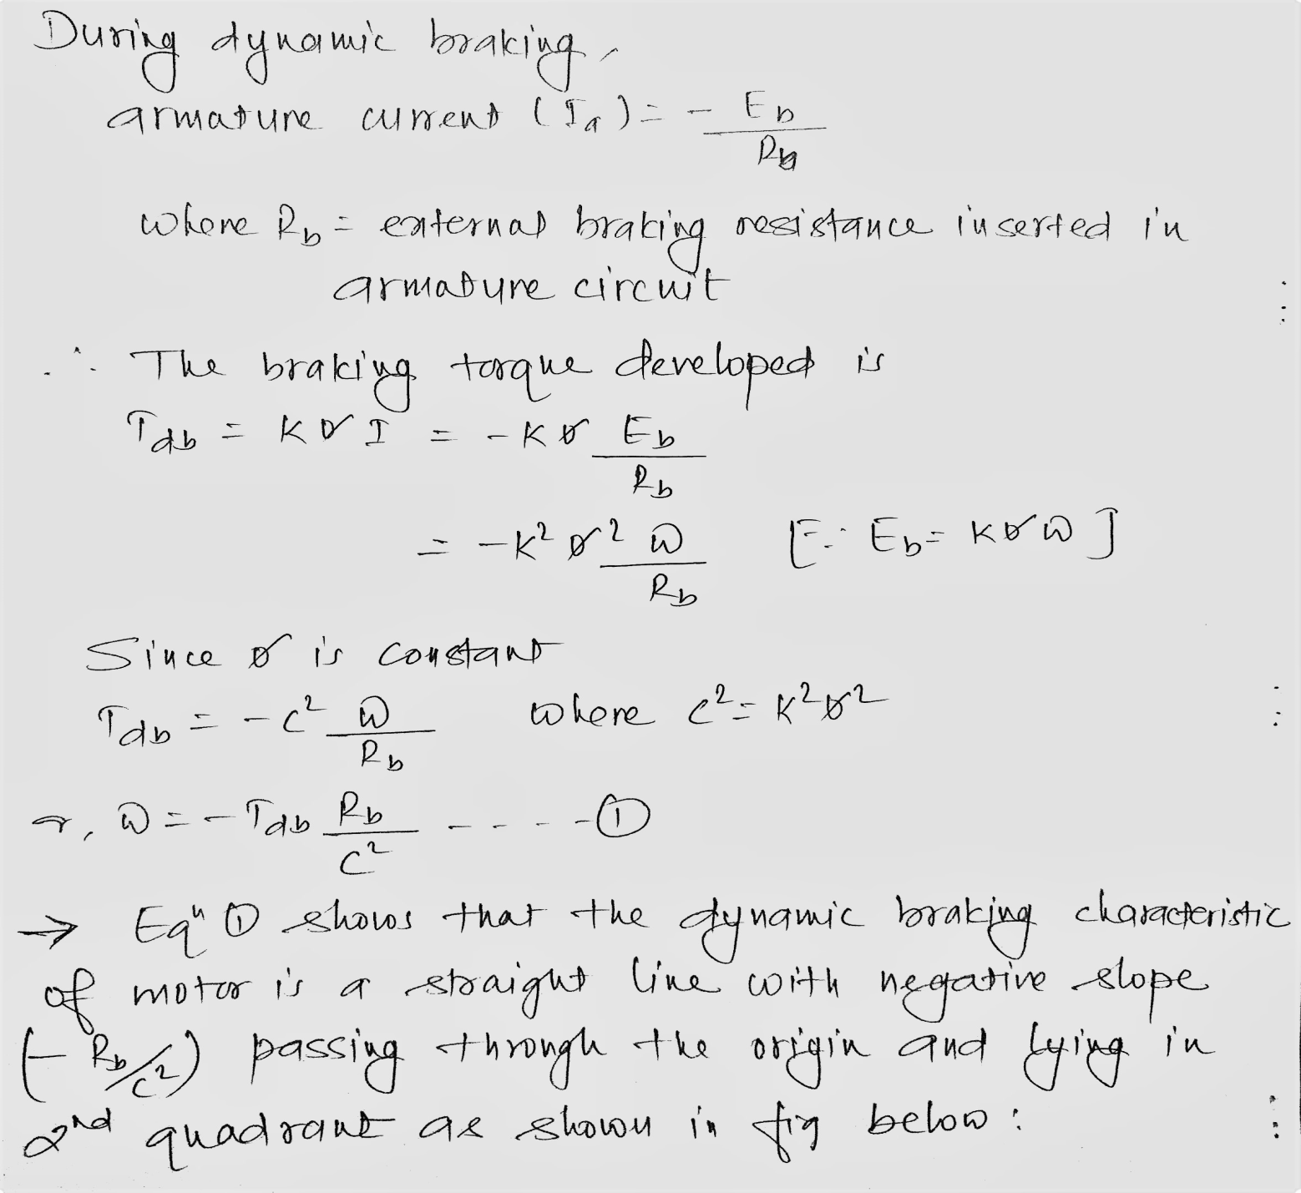

Slide 5
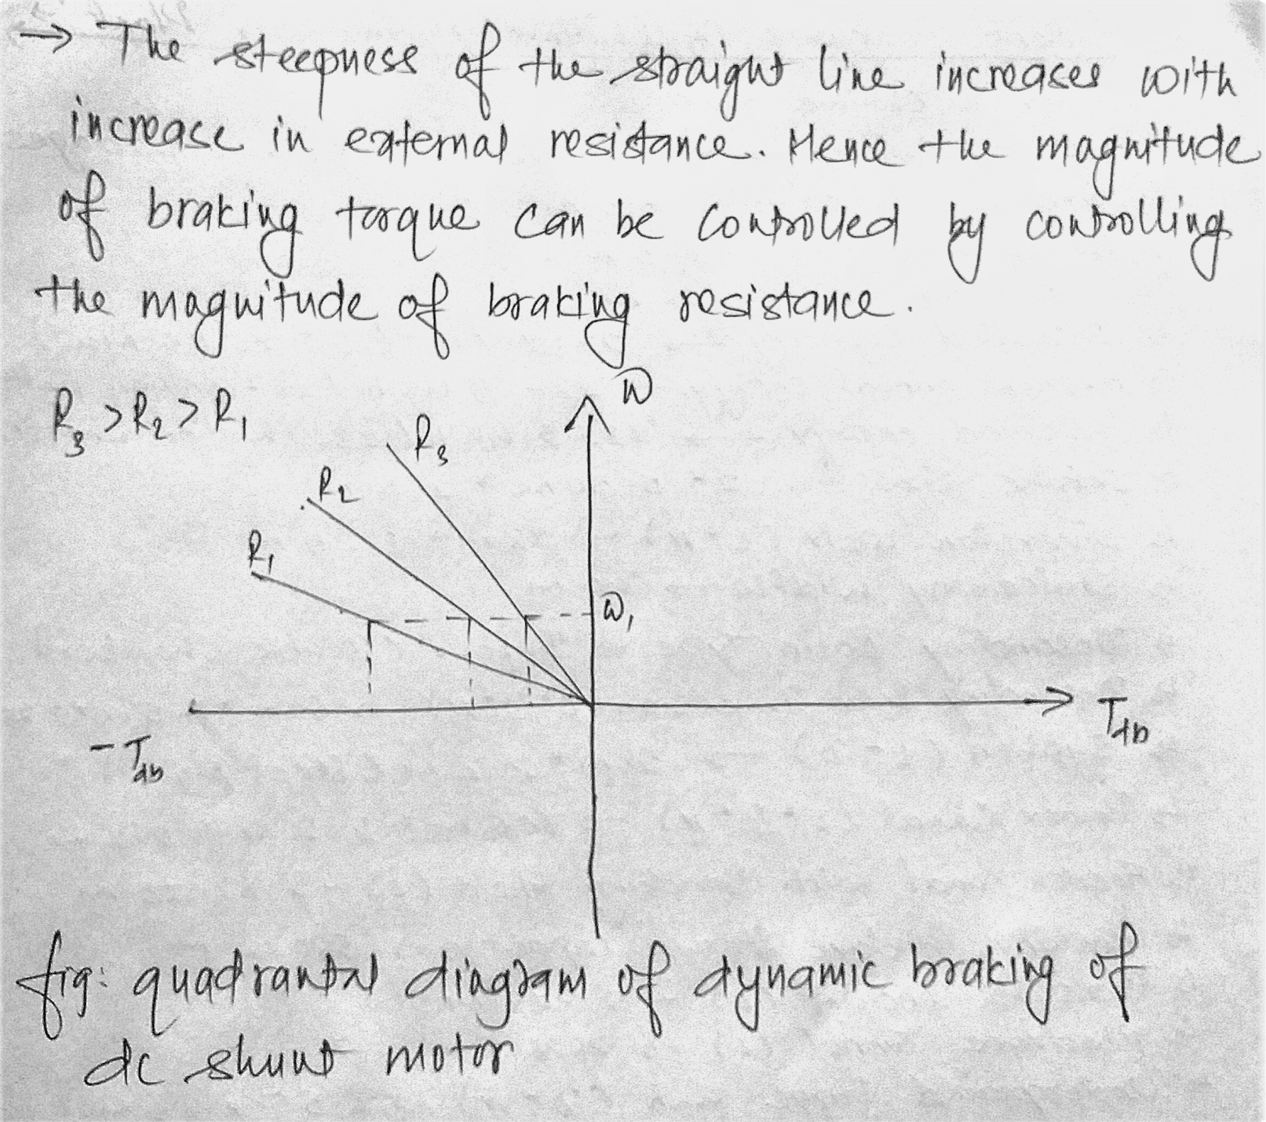

Slide 6
From the figure we can see that for the motor operating at the particular speed the braking torque developed is more for the lower resistance and less for higher resistance.
Also the braking effect can be controlled by controlling the magnitude of resistance of field excitation.
A major disadvantage is that the braking torque is zero when the excitation fails. This difficulty can however be overcome by connecting the series field in armature circuit during braking only.

Slide 7
Dynamic braking in dc series motor
For Dynamic Braking, the series motor is disconnected from the supply. A variable resistance R_{b} as shown in the figure below is connected in series, and the connections of the field windings are reversed.
The field connections are reversed so that the current through the field winding flows in the same direction as before i.e. from S₁ to S₂ so that the back EMF produces the residual flux. The machine now starts working as a self-excited series generator.
In self-excitation, the braking operation is slow. Hence, when a quick braking is required, the machine is connected in separate-excitation mode. A suitable resistance is connected in series with the field to limit the current to a safe value.

Slide 8
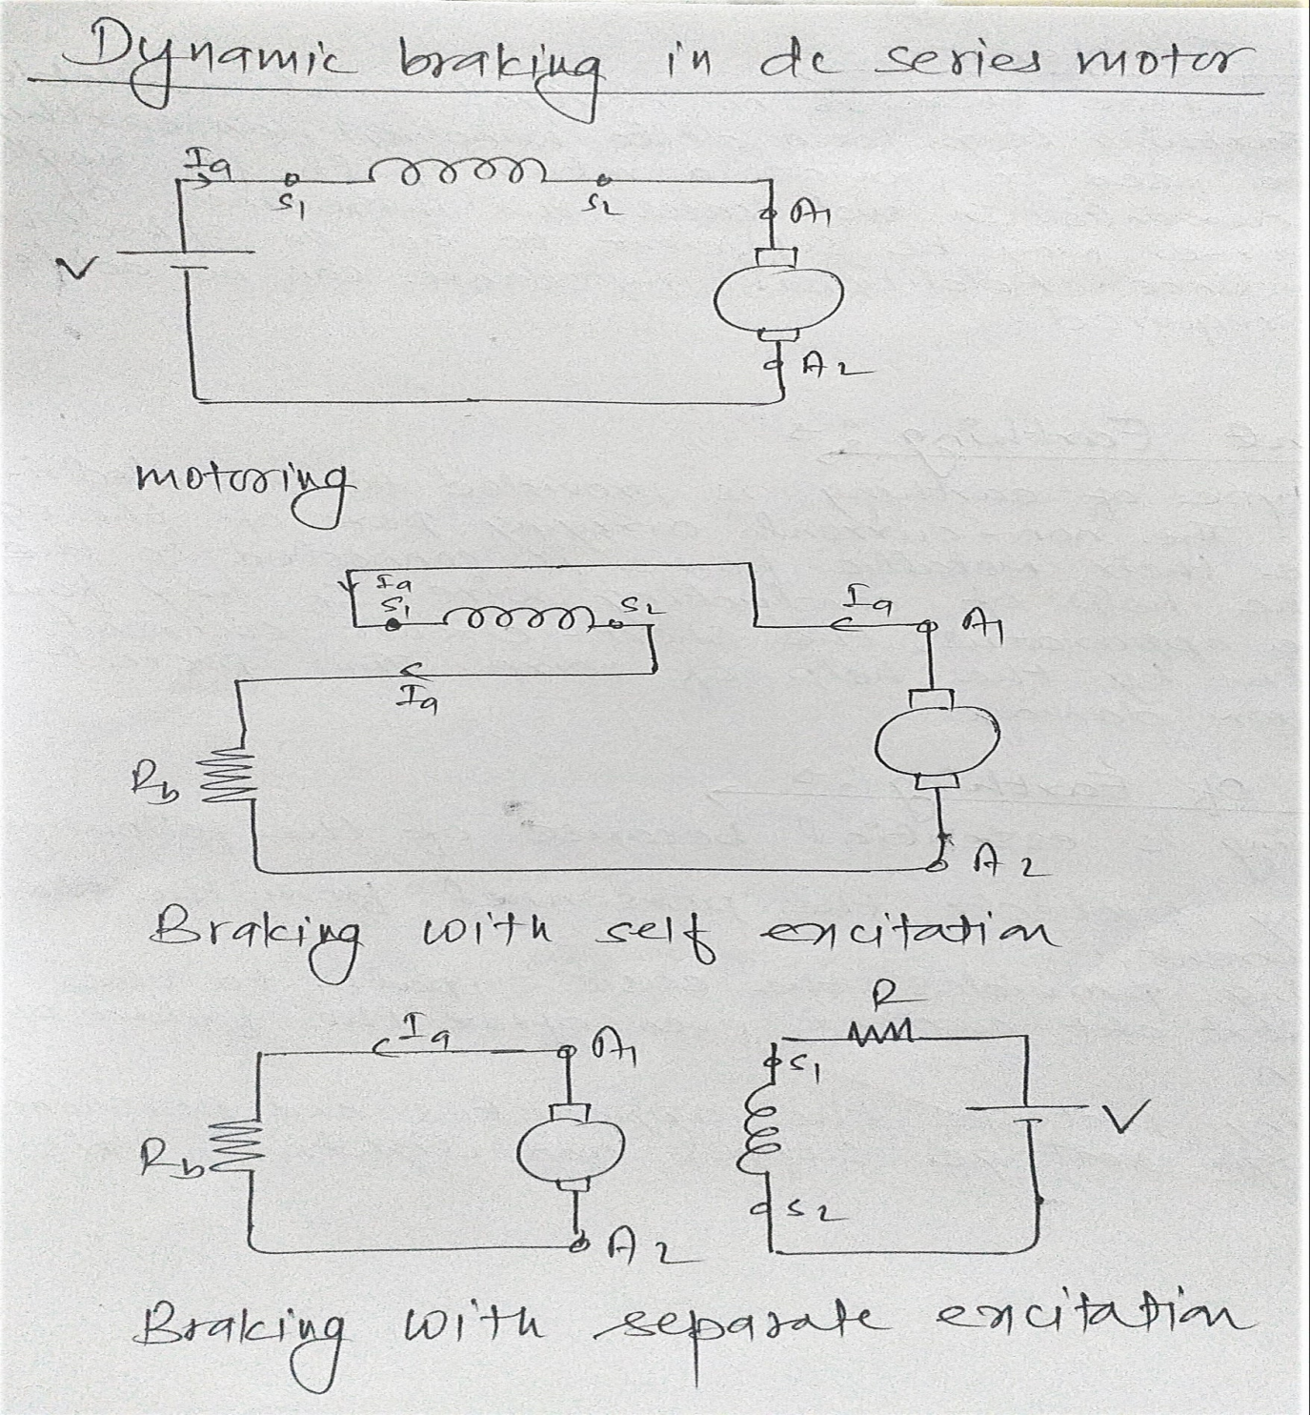

Slide 9
Dynamic braking in induction motor
Types of dynamic braking:
AC dynamic braking
Self excited braking using capacitor
Dc dynamic braking
Zero sequence braking

Slide 10
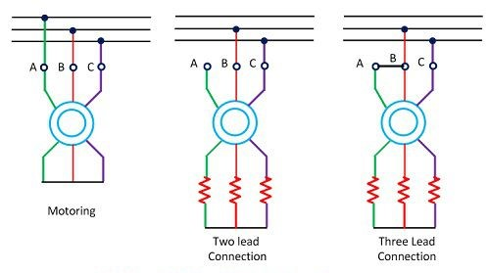
AC dynamic braking

Slide 11
AC dynamic braking(contd)
The dynamic braking is obtained when the motor is run on the single phase supply by disconnecting the one phase from the source and either leaving it open or connecting it with another phase.
The two connections are respectively known as two and three lead connection.
When connected to a 1-phase supply, the motor can be considered to be fed by positive and negative sequence three-phase set of voltages. Net torque produced by the machine is sum of torques due to positive and negative sequence voltages. When rotor has a high resistance, the net torque is negative and braking operation is obtained.

Slide 12
